Slide 1

How To Complete the Paper Tangible Personal Property Tax Filing
[Note: A Frequently Asked Questions (FAQs) section is located at the end of this guide.]

Slide 2
All businesses that operate in Tennessee are subject to Tangible Personal Property Tax, regardless of revenue. (Tennessee Code Annotated Title 67 - Chapter 5 - Part 9)
What is Tangible Personal Property ?
Tangible Personal Property is the equipment and assets used (or held for use) in your business as of January 1. This includes, but is not limited to, furniture, fixtures, vehicles, hand and power tools, machinery, computers, cell phones, raw materials, and supplies
Items that are expensed or fully depreciated on your accounting records but still in use should be reported.
Items you lease or rent from another company to use in the business are considered tangible personal property and should be reported.
Inventory and merchandise held for sale or finished goods in the hands of the manufacturer are not considered tangible personal property and should not be reported.

Slide 3
How do I report my Tangible Personal Property?
The Assessor’s Office will mail each business a Tangible Personal Property Schedule every year. If you do not receive one, you may download a blank form from our website https://mcgtn.org/assessor/tangible-personal-property . Not receiving a schedule does not relieve your responsibility of filing.
Tangible Personal Property Schedules are mailed out in January and due back to the Assessor’s Office by March 1 every year.
Schedules post marked or received 1 March and earlier will be accepted as timely filed. Timely filed schedules may be amended thru 1 September of the following year and are entitled to the appraisal ratio for that tax year, if applicable.
Schedules post marked or received 2 March thru the adjournment of the County Board of Equalization may not be amended and are not entitled to the appraisal ratio for that tax year if applicable.
Schedules post marked or received after the County Board of Equalization has adjourned must be accompanied by a notarized “Request for Relief from Forced Appraisal” form. They may not be amended, are not entitled to the appraisal ratio for that tax year if applicable, and will have appraised value increased by 25% as penalty.
1 March 2026 falls on Sunday. Schedules received in person, on-line, or via mail post marked on or before Monday 2 March 2026 will be accepted as timely filed.
SCHEDULES ARE NOT ACCEPTED VIA EMAIL. If you are filing a paper schedule it must be returned to the Assessor’s office either by mail or in person at 350 Pageant Ln Ste. 101-C Clarksville, TN 37040.

Slide 4
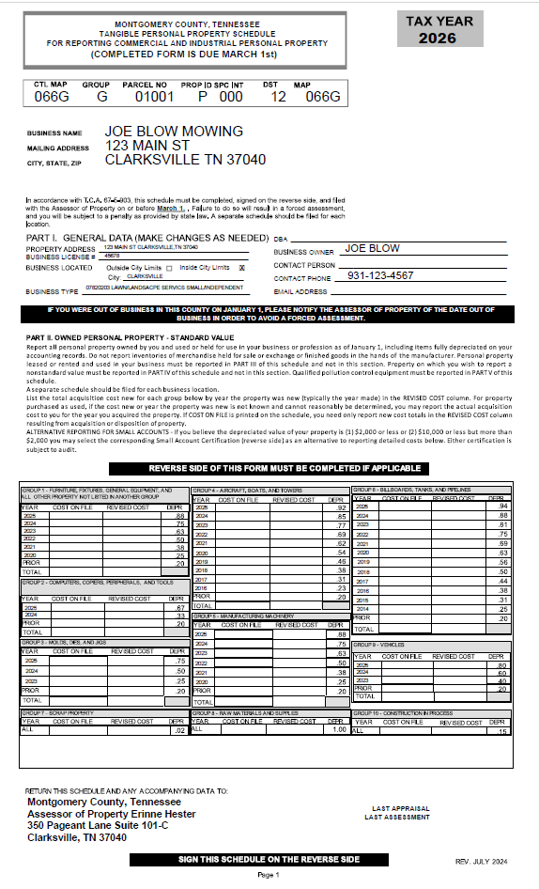
The business information will be printed on the front of the schedule.
If this is your first year in business the boxes at the bottom of the page will be blank. There will be a zero in the total box for each group and in the last appraisal/last assessment lines at the bottom right.
If you have filed before, the value of the items you previously reported will be in the corresponding year boxes for each group. The appraisal and assessment values from last year will be on the bottom right.
If there are zeros in the group boxes and values in the last appraisal and last assessment, you either received a forced assessment last year or chose one of the small account certifications.
$2,000 or $10,000

Slide 5
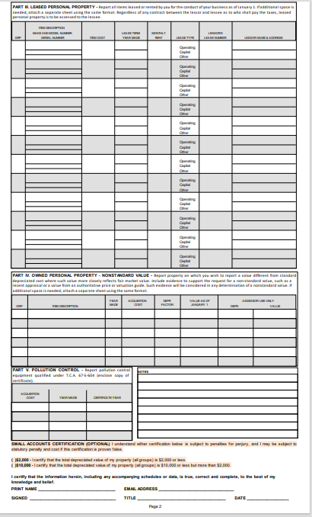
On the back, you will need to list any items you lease for use in the business in Part III.
There are two small account options for 2026. On the back of the schedule and the front of the yellow form check the option that best describes the total depreciated value of the assets used in your business. An asset list or depreciation schedule is not required. However, small accounts are subject to audit, meaning the assessor’s office can ask you to provide a list showing purchase date and purchase price of all equipment to verify the business qualifies for one of the two small account certifications.
IF YOU CHOOSE ONE OF THE SMALL ACCOUNT CERTIFICATIONS YOUR APPRAISED VALUE WLL BE SET AT $2,000 OR $10,000
At the bottom print your name and sign, provide your email address, title, and date.

Slide 6
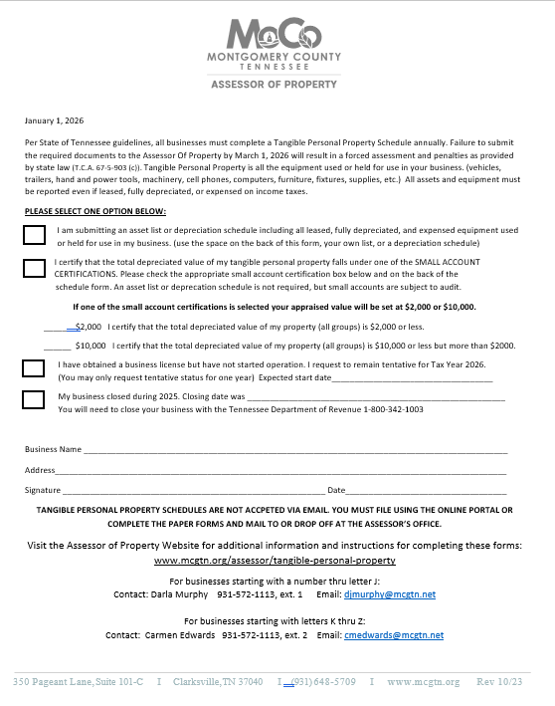
IF THIS IS YOUR FIRST TIME FILING YOUR ASSET FORM IS GREEN
ON THE FRONT OF THE ASSET FORM CHOOSE ONE OF THE FOUR OPTIONS
Check the submit an asset list or depreciation schedule box
OR
Check one of the small account certification boxes. (read about the small account certifications in the FAQ section)
OR
IF YOU HAVE OBTAINED A BUSINESS LICENSE BUT NOT STARTED OPERATIONS
Check the Request to Remain tentative for 2026 box ( This means you will not pay Tangible Personal Property Tax for 2026. You may only request tentative status one year. Please proved an expected start date.)
OR
IF THE BUSINESS CLOSED DURING 2025. Check the last box and provide the closure date.

Slide 7
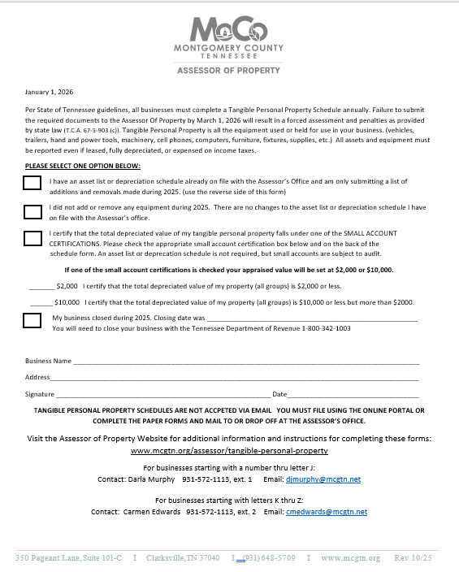
IF YOU FILED LAST YEAR YOUR ASSET FORM IS YELLOW
ON THE FRONT OF THE ASSET FORM CHOOSE ONE OF THE FOUR OPTIONS
Check the box stating you are submitting additions to or removals from the asset list on file.
OR
Check the no changes box if you did not add or remove any equipment during 2025
OR
Existing businesses that qualify may also choose one of the two small account certifications. (read about the small account certifications in the FAQ section)
OR
IF THE BUSINESS CLOSED DURING 2025.
Check the last box and provide the closure date. If the business closed before 2025 please contact the Assessor’s office, as more information may be needed to close the account.

Slide 8
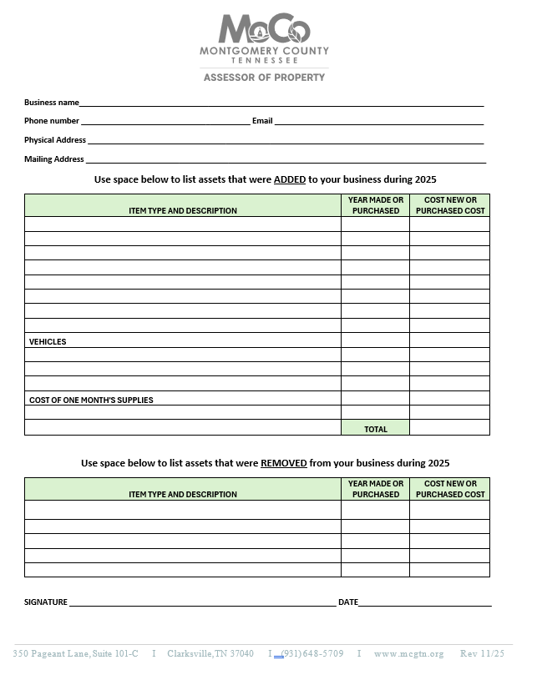
THE BACK OF THE ASSET FORM IS VERY IMPORTANT!! Please complete the top section every year to ensure we have your current physical and mailing address, email, and phone number. Keep a copy of this asset list to refer to next year.
If you are using this form to submit an asset list report all assets and equipment used in the business, year purchased, and purchase amount. If you do not know the exact year or exact purchase amount, estimate as closely as possible.
You must report ALL ITEMS being used in the business, whether you purchased the item for the business, are using something you already owned, borrowed, made or was given to you. Report any leased items. Items that are fully depreciated on your accounting records for income tax purposes but are still being used in the business must be reported.
Vehicles must be reported if more than 50% of their use is for business purposes, if you claim the vehicle mileage as an expense on the business’s income tax, or if it is titled in the business name, or has commercial license plates. If the vehicle meets any of these criteria it must be reported.
Finally report an average of what you spend a month on supplies. These are expendable items you buy on a regular basis to support the business activity (office or cleaning supplies, stocks of spare parts etc.)

Slide 9
SAMPLE ASSET LIST
ITEM TYPE AND DESCRIPTION | YEAR MADE OR PURCHASED | COST NEW OR PURCHASED COST
John Deere Zero Turn Mower | 2025 | 13,900
Flatbed Trailer | 2021 | 3,000
Weedeater | 2022 | 499
Blower | 2022 | 279
Chain Saw | 2020 | 499
Hand Tools | 2018 | 200
Rake, Shovel,Pruner | 2018 | 75
Plastic Gas Cans X 3 | 2021 | 45
Cell Phone | 2024 | 1300
VEHICLES
2018 Silverado | 2022 | 38,000
COST OF ONE MONTHS SUPPLIES |  | 65
 | TOTAL | 37,562

Slide 10
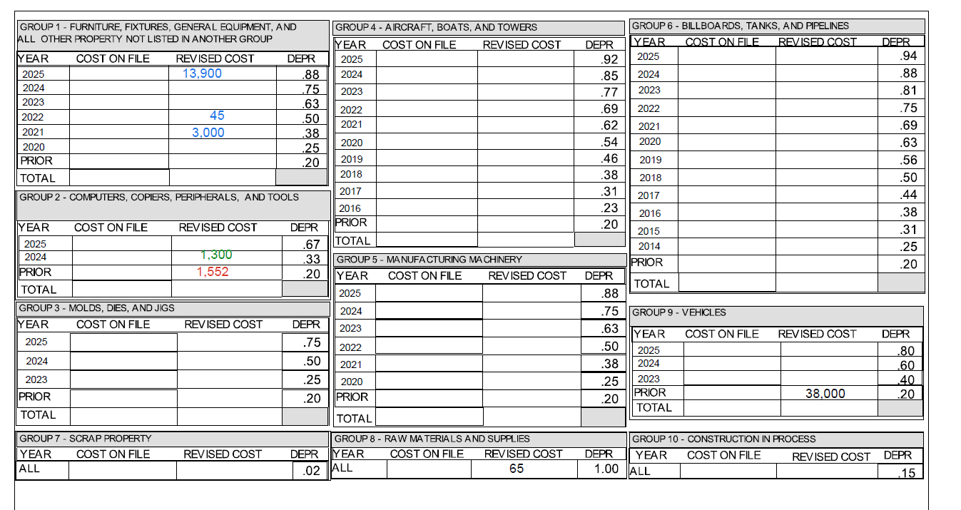
The Assessor’s Office Tangible Personal Property Staff will enter the information from the asset list into the depreciation table , based on the group each item belongs in and purchase year.
ITEM TYPE AND DESCRIPTION | YEAR MADE OR PURCHASED | COST NEW OR PURCHASED COST
John Deere Zero Turn Mower (Grp 1) | 2025 | 13,900
Flatbed Trailer (Grp 1) | 2021 | 3,000
Weed-eater (Grp 2) | 2022 | 499
Blower (Grp 2) | 2022 | 279
Chain Saw (Grp 2) | 2020 | 499
Hand Tools (Grp 2) | 2018 | 200
Garden Tools (rakes, shovels) (Grp 2) | 2018 | 75
Plastic Gas Cans X 3 (Grp 1) | 2022 | 45
Cell Phone (Grp 2) | 2024 | 1300
LIST ALL VEHICLES
2018 Silverado (Grp 9) | 2022 | 38,000
COST OF ONE MONTHS SUPPLIES | AS OF 1/1/2025 | (Grp 8 ) 65
 | TOTAL | 57,862

Slide 11
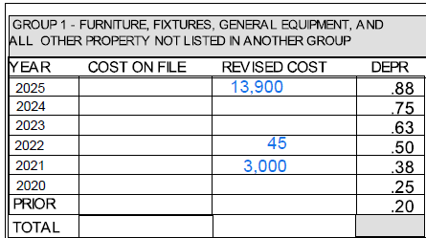
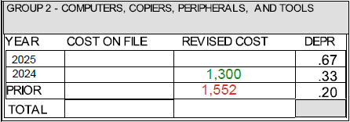

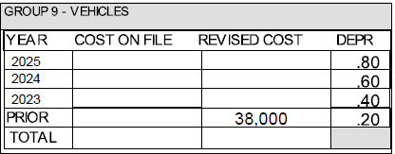
Once all the items are in the correct group and year, the depreciated value is figured for each item and totaled. The total is your APPRAISED VALUE.
The appraised value is multiplied by 30% (the assessment level for Tangible Personal Property) to get the ASSESSED VALUE.
The City of Clarksville & Montgomery County tax rates are applied to the assessed value to calculate the TANGIBLE PERSONAL PROPERTY TAX DUE.
Appraised Value= $21,799
X
30% Assessment Level
_________________________
Assessed Value = $ 6,540
Tax Rates as of 1 July 2025
Montgomery Co 2.10%
Clarksville City .92%
County Taxes due
$6,540 x .0210= $ 137 (ROUNDED)
City Taxes due
$6,540 x .0092= $ 60 (ROUNDED)
13,900 X .88=12,232
45 X.50 = 23
3000 X.38 = 1,140
1,300x .33= 429 1,552 x .20= 310
65 x 1.00 = 65
38,000 x .20= 7,600

Slide 12
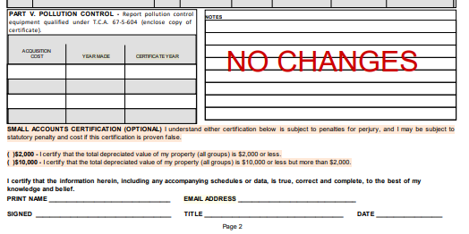
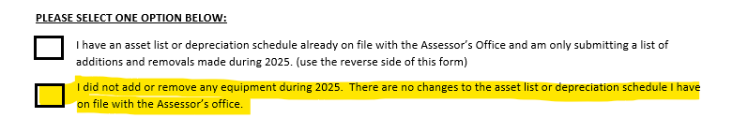
What if I do not have any changes?
The schedule should be turned in every year to the Assessor’s Office to receive the yearly depreciation and avoid any applicable penalties. If you did not add or remove any equipment during 2025 sign and date the back of the schedule form and write NO CHANGES in the notes box. You may also check the no change box on the front of the asset form or check the no changes box in the online portal.
What if I do not file an asset list?
If no asset list is filed, you will be forced assessed. This means if you have filed an asset previously, this year’s assessment will be based on the previously filed amounts with no depreciation deducted. If you have never filed, you will be assessed at the average amount that was reported by similar businesses.

Slide 13
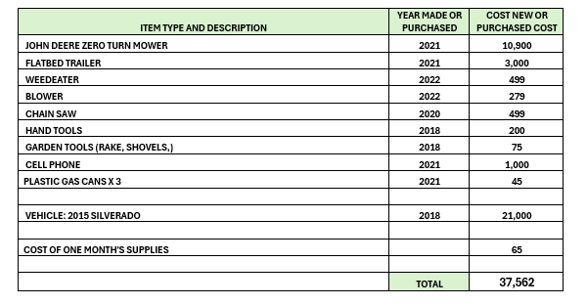
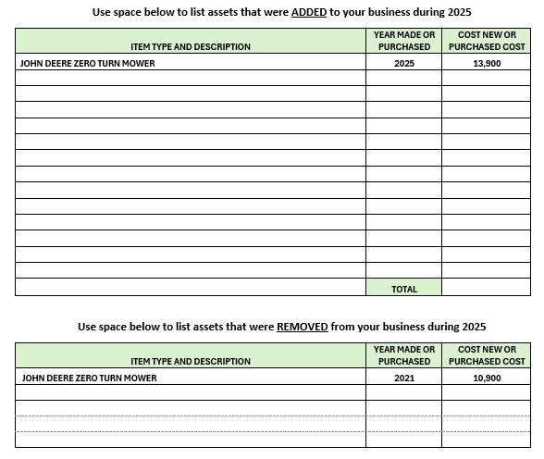
What if I provided an asset list last year? Do I need to list all the same items again? NO!, look on last year’s asset list and see if you added or got rid of any equipment during 2025. If you did, list only the additions and removals on this year’s asset list.

Slide 14
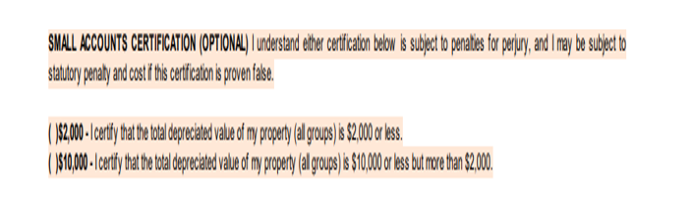
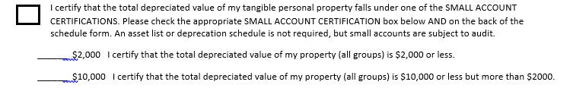
WHAT IF I ONLY HAVE A SMALL AMOUNT OF ASSETS AND EQUIPMENT? There are two small account options for 2026. On the back of the schedule and the front of the asset form check the option that best describes the total depreciated value of the assets used in your business. An asset list or depreciation schedule is not required. However, small accounts are subject to audit, meaning the assessor’s office can ask you to provide a list showing purchase date and purchase price of all equipment to verify the business qualifies for one of the small account certifications. If you select one of the small account certifications your appraised value will be set at $2,000 or $ 10,000 APPRAISED VALUE X 30% ASSESSMENT LEVEL = ASSESSED VALUE X TAX RATE = TAXES DUE FOR EXAMPLE: $2,000 x 30% = $ 600 x .0210 2025 COUNTY TAX RATE = $13(ROUNDED) $2,000 x 30% = $ 600 x .0092 2025 CITY TAX RATE = $6 (ROUNDED)

Slide 15

Don’t hesitate to contact us if you have questions. We are here to help !
Businesses beginning with numbers - letter J
Darla Murphy
djmurphy@mcgtn.net
931-572-1113 ext. 1
Businesses beginning with letters K-Z
Carmen Edwards
cmedwards@mcgtn.net
931-572-1113 ext. 2

